Slide 1
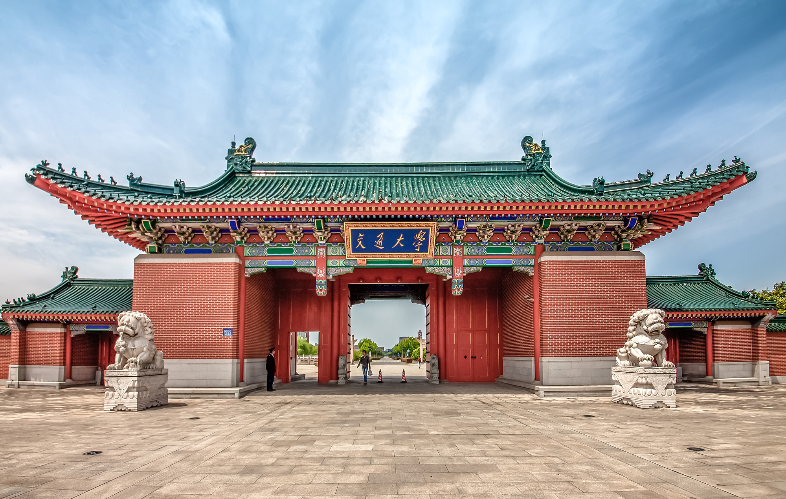
学术写作、规范与伦理
学术论文写作与发表规范 - I
张晗
2021.09

Slide 2
论文到底是什么？
百度百科：
论文 常用来指进行各个学术领域的研究和描述学术研究成果的文章，简称之为论文。它既是探讨问题进行学术研究的一种手段，又是描述学术研究成果、进行学术交流的一种工具。
描述学术研究成果
进行学术交流、探讨问题
有效地与读者沟通！
逻辑性是论文的根本！

Slide 3


01
02
03
04
结构的逻辑性
语句的逻辑性
论证的逻辑性
写作规范
05
06
07
08
Abstract &
Keywords
Introduction
Main Results
Conclusion

Slide 4
01
02
03
04
结构的逻辑性
语句的逻辑性
论证的逻辑性
写作规范
05
06
07
08
Abstract &
Keywords
Introduction
Main Results
Conclusion

Slide 5


动笔写论文之前……
动笔写论文之前，首先需回答：
什么是我最重要的发现？
为什么我的研究是重要的？对谁而言是重要的？
动笔之前先问问自己：
为什么我的研究是重要的？
这篇论文专注于回答什么科学问题？
这篇论文想要达成什么目的？
这篇论文该如何回答上述科学问题？对该领域的贡献？
重要性取决于领域与研究背景！
如何描述学术成果？

Slide 6
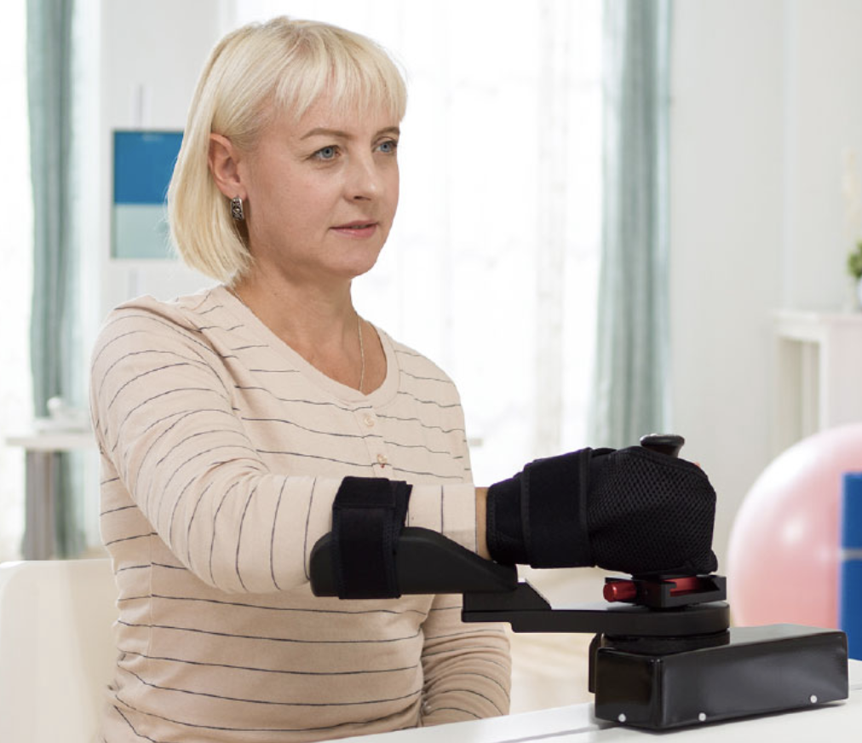
动笔写论文之前……
不能用太专业的词汇！
医疗康复机器人
为什么我的研究是重要的？ （对患者、医生、医疗企业来说，……）
这篇论文专注于回答什么科学问题？ （揭示了新的人机交互机理）
这篇论文想要达成什么目的？ （设计新的交互方式，使得患者更快康复）
叙述交互方式的设计
设计实验验证

Slide 7
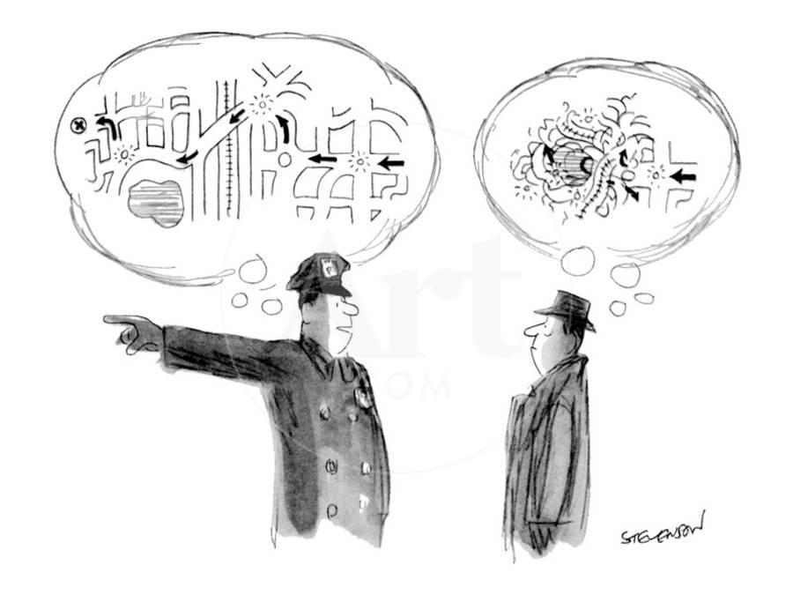
站在读者的角度写作
作者 vs 读者：
作者：
花费大量时间写作
对要表达的内容滚瓜烂熟
读者：
工作空闲时阅读
第一次阅读你的工作
永远不要默认读者具备和作者相同的知识！！

Slide 8
站在读者的角度写作
三类读者：
编辑
审稿人
学术同行
合适性
可信性
可重复性
主题的专业性
技术的专业性
读者期待的：
用符合阅读逻辑的写作满足读者的期待

Slide 9
引导你的读者
写好文章的大纲
引导读者的三段论：
问题 → 方法（阐述） → 结论
问题：
问题产生的背景
问题的科学描述
前人工作、问题的难点（问题仍未完全解决）
结构：
总 —分—总

Slide 10
引导你的读者
写好文章的大纲
引导读者的三段论：
问题 → 方法（阐述） → 结论
方法（阐述）：
并列 / 递进
结论：
需提纲挈领，给读者
take-home message
结构：
总 —分—总

Slide 11
以本课程为例……
问题
背景： 1. 论文是探讨问题进行学术研究的一种手段，又是描述学术研究成果、进行学术交流的一种工具。 2. 论文写作是每个研究生的必由之路。
科学描述： 如何高效地与读者沟通，让整篇文章具有良好的逻辑性和阅读体验，使读者快速了解你的idea
难点： 1. 行文结构的逻辑性 2. 语句的逻辑性 3. 论证的逻辑性 4. 写作的规范性

Slide 12
以本课程为例……
方法
动笔写论文之前，想清楚如何描述你的学术成果
站在读者的角度写作
写好大纲
……
结论
让学生们对论文写作方法有了初步的了解
阐述了论文写作技巧的方法论
按照方法论写作，能切实提高论文的质量

Slide 13
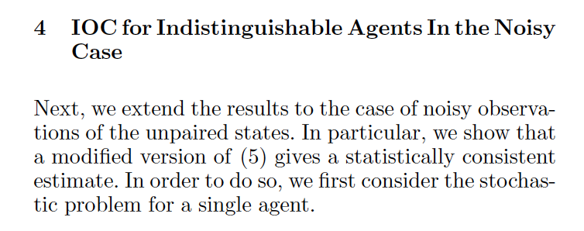
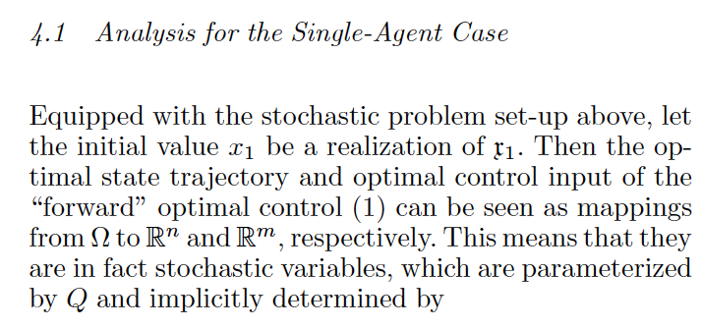
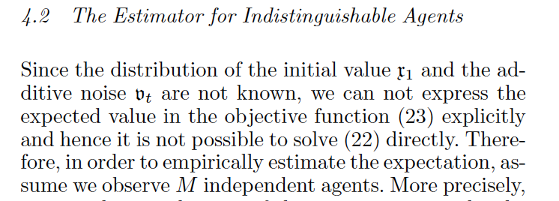
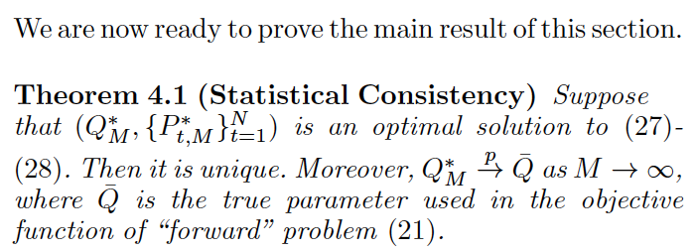
小技巧
告诉读者这个Section要干啥
总结整个Section

Slide 14
01
02
03
04
结构的逻辑性
语句的逻辑性
论证的逻辑性
写作规范
05
06
07
08
Abstract &
Keywords
Introduction
Main Results
Conclusion

Slide 15
节省读者的能量
增强论述的清晰度
避免认知偏差
满足读者的期望：用逻辑流引导你的读者
采用合适的语态

Slide 16
增强论述的清晰度
Economists considered Weinheimer Industries, a large German trading corporation founded in 1816 outside of Berlin by Christoph Weinheimer, to be a model in the development of modern employee conditions worldwide.
30 秒时间阅读……

Slide 17
增强论述的清晰度
Q1：
When is the company founded?
Q2：
Where is the company founded?
Q3：
Who founded the company?
Q4：
What is the author’s main message? Why this company is important?

Slide 18
增强论述的清晰度
Economists considered Weinheimer Industries, a large German trading corporation founded in 1816 outside of Berlin by Christoph Weinheimer, to be a model in the development of modern employee conditions worldwide.
30 个英文单词！！

Slide 19
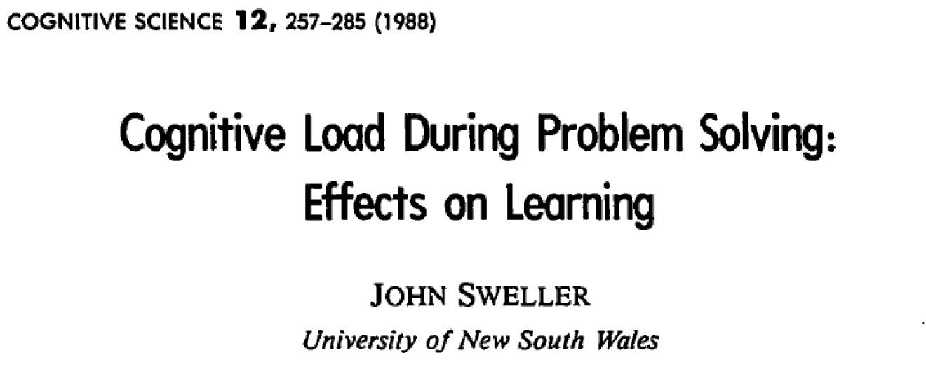
增强论述的清晰度
用简短的句子！！
句子长度 | 回忆率
10 | 98%
20 | 85%
30 | 70%
50 | 58%

Slide 20
增强论述的清晰度
目标：
每句话10-20个单词：
或长或短不严格要求
长短结合会让阅读变得有趣
每句话只讲一个idea：
只在必要时使用分号
确保充分地向读者表述了该问题

Slide 21
增强论述的清晰度
Economists considered Weinheimer Industries, a large German trading corporation founded in 1816 outside of Berlin by Christoph Weinheimer, to be a model in the development of modern employee conditions worldwide.
重要信息：
Weinheimer Industries的历史
这个公司为什么重要？（对你的论文的理论为什么重要？）

Slide 22
增强论述的清晰度
Economists considered Weinheimer Industries, a large German trading corporation founded in 1816 outside of Berlin by Christoph Weinheimer, to be a model in the development of modern employee conditions worldwide.
Economists considered Weinheimer Industries to be a model in modern employee conditions development worldwide.
This large German trading corporation was founded in 1816 outside of Berlin by Christoph Weinheimer.

Slide 23
增强论述的清晰度
Economists considered Weinheimer Industries, a large German trading corporation founded in 1816 outside of Berlin by Christoph Weinheimer, to be a model in the development of modern employee conditions worldwide.
这个公司为什么重要？
Economists considered Weinheimer Industries to be a model in modern employee conditions development worldwide.
This large German trading corporation was founded in 1816 outside of Berlin by Christoph Weinheimer.
这个公司历史

Slide 24
增强论述的清晰度
避免不必要的短语：
避免使用对解释你的idea没有价值的短语
简单的规则： 如果删掉这些短语，是否会改变句子的意思？ 若否，则删掉这些短语！
废话文学：
俗话说得好：“俗话说得好”
听君一席话，如听一席话
一周不见，如隔七天

Slide 25
增强论述的清晰度
避免废话：
It is well known that Pontryagin Maximum Principle provide necessary optimality conditions…
As a matter of fact, the system turns out to be highly nonlinear…
A number of studies have shown that model predictive control is…
It is worth mentioning that the policy implementation is…
as described previously in our previous study.

Slide 26
增强论述的清晰度
用简练的语句：
That is another reason why Therefore, we believe…
In order to To evaluate the system performance
Despite the fact that Although Hamiltonian Jacobi Bellman Equation is difficult to solve…
It is clear that Clearly the system would diverge if …
It is evident that…
It is possible…
It is interesting to note that…
Evidently…
Possibly…
Notably…

Slide 27
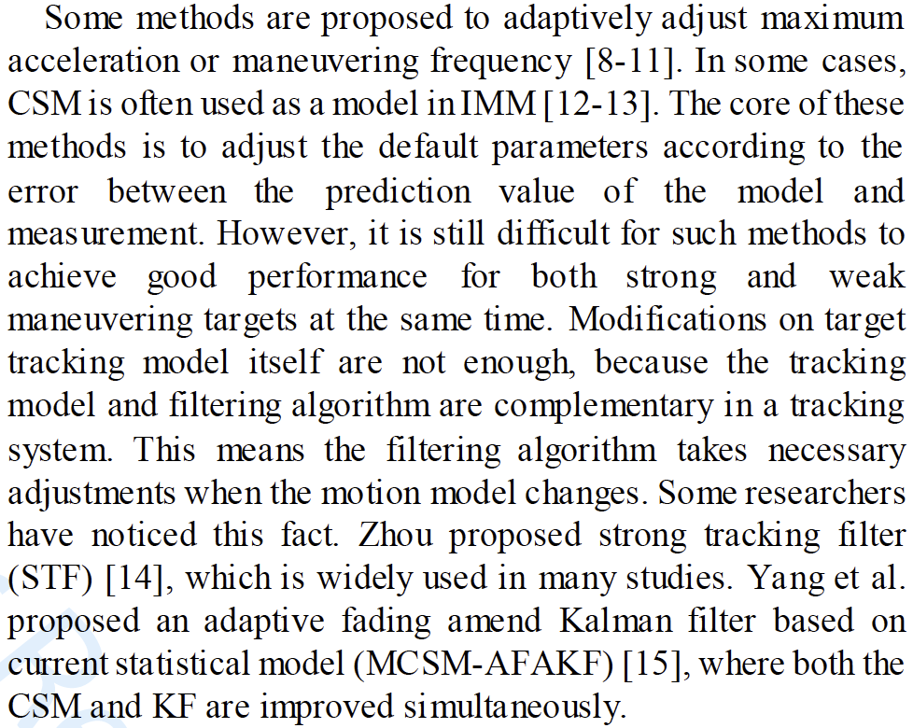
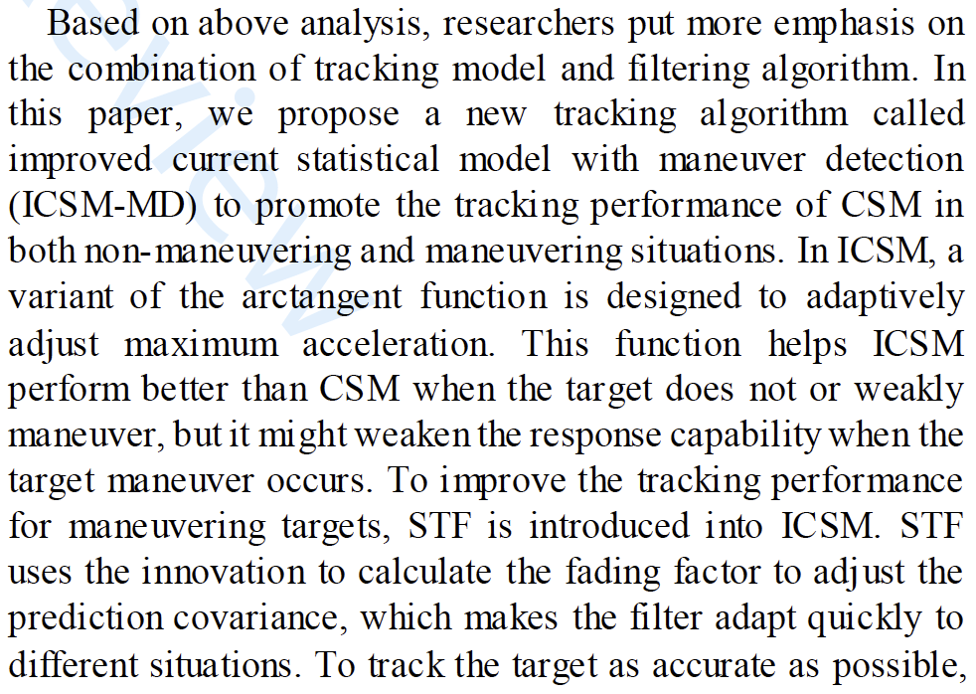
增强论述的清晰度
尽量避免缩写
逼迫你的读者记住这些缩写？？？

Slide 28
避免认知偏差
清晰地向你的读者介绍你的idea：
含糊的主语
This, that, these, those, they, it
The study by Robens et al. randomly allocated 320 and 331 participants into the experimental and control groups, respectively.
They were then blinded as to whom received each intervention.
谁是They？Robens et al. 还是participants？

Slide 29
避免认知偏差
清晰地向你的读者介绍你的idea：
含糊的主语
This, that, these, those, they, it
The study by Robens et al. randomly allocated 320 and 331 participants into the experimental and control groups, respectively.
The participants were then blinded as to whom received each intervention.

Slide 30
避免认知偏差
清晰地向你的读者介绍你的idea：
定性的词语
Some, most, about, few
100 monte carlo simulations has been performed. Only few of them has failed to converge to optimum…
多少是“few”？1个？5个？15个？

Slide 31
避免认知偏差
清晰地向你的读者介绍你的idea：
定性的词语
Some, most, about, few
100 monte carlo simulations has been performed. Six (6%) of them have failed to converge to optimum,…

Slide 32
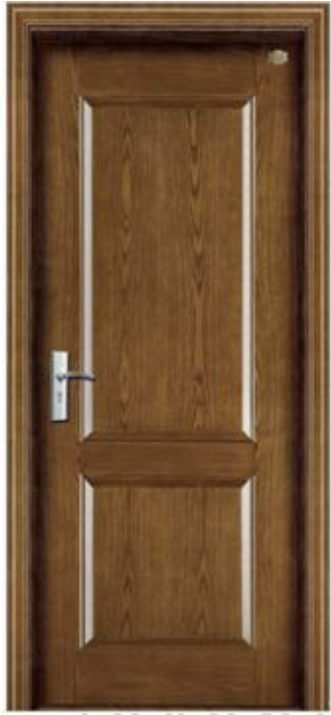
满足读者的期望
符合逻辑性：
EXIT
Signposting
引导你关键的词、短语
读者能够更快地理解你所期望表达的观点
善用关联词

Slide 33
满足读者的期望
关联词：
转折：
However
Whereas
On the other hand
Nevertheless
Although
Yet
Despite
In contrast to
By contrast
类似：
Likewise
Similarly
Also
As well
递进：
Additionally
Furthermore
Moreover
总结：
Therefore
Consequently
Thus
As a result (of)
Due to
Because of

Slide 34
满足读者的期望
让你的语句符合逻辑规律：
读者会把注意力聚焦于句子的末尾以决定什么是重要的信息
例子：
You deserve a raise, but the budget is tight.
The budget is tight, but you deserve a raise.
“Stress Position”
善用“Stress Position”来强调你idea中重要的部分

Slide 35
满足读者的期望
让你的语句符合逻辑规律：
“强调位置”也用于衔接下一句话的内容
Signposting
例子：
The budget is tight, but you deserve a raise. Your salary will increase at the beginning of next year
“Stress Position”

Slide 36
满足读者的期望
例子：
In nature, agents tend to behave and choose their actions in an optimal way, for instance, animal gaits, the timing to hatch queens in bee hives, the way people buy and sell stocks. All of these optimal behaviors can be seen as solutions to some specific optimal control problems. The goal of a classical optimal control problem is to find the optimal control input as well as the optimal trajectory when the cost function, system dynamics, and initial conditions are given. In contrast, the objective of an inverse optimal control problem is to “reverse engineer" the cost function, given observations of optimal trajectories or control inputs, for known system dynamics. The cost function is of great interest because it can help one to understand how individuals make decisions and take actions.
Moreover, knowledge of an agent's cost function may enable one to predict the future behavior of the agent.

Slide 37
满足读者的期望
例子：
In nature, agents tend to behave and choose their actions in an optimal way, for instance, animal gaits, the timing to hatch queens in bee hives, the way people buy and sell stocks. All of these optimal behaviors can be seen as solutions to some specific optimal control problems. The goal of a classical optimal control problem is to find the optimal control input as well as the optimal trajectory when the cost function, system dynamics, and initial conditions are given. In contrast, the objective of an inverse optimal control problem is to “reverse engineer" the cost function, given observations of optimal trajectories or control inputs, for known system dynamics. The cost function is of great interest because it can help one to understand how individuals make decisions and take actions.
Moreover, knowledge of an agent's cost function may enable one to predict the future behavior of the agent.

Slide 38
满足读者的期望
例子：
In nature, agents tend to behave and choose their actions in an optimal way, for instance, animal gaits, the timing to hatch queens in bee hives, the way people buy and sell stocks. All of these optimal behaviors can be seen as solutions to some specific optimal control problems. The goal of a classical optimal control problem is to find the optimal control input as well as the optimal trajectory when the cost function, system dynamics, and initial conditions are given. In contrast, the objective of an inverse optimal control problem is to “reverse engineer" the cost function, given observations of optimal trajectories or control inputs, for known system dynamics. The cost function is of great interest because it can help one to understand how individuals make decisions and take actions.
Moreover, knowledge of an agent's cost function may enable one to predict the future behavior of the agent.
Signposting

Slide 39
满足读者的期望
例子：
In nature, agents tend to behave and choose their actions in an optimal way, for instance, animal gaits, the timing to hatch queens in bee hives, the way people buy and sell stocks. All of these optimal behaviors can be seen as solutions to some specific optimal control problems. The goal of a classical optimal control problem is to find the optimal control input as well as the optimal trajectory when the cost function, system dynamics, and initial conditions are given. In contrast, the objective of an inverse optimal control problem is to “reverse engineer" the cost function, given observations of optimal trajectories or control inputs, for known system dynamics. The cost function is of great interest because it can help one to understand how individuals make decisions and take actions.
Moreover, knowledge of an agent's cost function may enable one to predict the future behavior of the agent.
Signposting

Slide 40
满足读者的期望
例子：
In nature, agents tend to behave and choose their actions in an optimal way, for instance, animal gaits, the timing to hatch queens in bee hives, the way people buy and sell stocks. All of these optimal behaviors can be seen as solutions to some specific optimal control problems. The goal of a classical optimal control problem is to find the optimal control input as well as the optimal trajectory when the cost function, system dynamics, and initial conditions are given. In contrast, the objective of an inverse optimal control problem is to “reverse engineer" the cost function, given observations of optimal trajectories or control inputs, for known system dynamics. The cost function is of great interest because it can help one to understand how individuals make decisions and take actions.
Moreover, knowledge of an agent's cost function may enable one to predict the future behavior of the agent.
Signposting

Slide 41
使用合适的语态
主动语态？被动语态？
用主动语态表达的句子更简单、直接、容易理解
被动语态：
The models comparing the economic growth and diversification of the Middle East and East Asia were evaluated.
What was being evaluated? Who evaluated?

Slide 42
使用合适的语态
主动语态？被动语态？
用主动语态表达的句子更简单、直接、容易理解
被动语态：
The models comparing the economic growth and diversification of the Middle East and East Asia were evaluated.
主动语态：
We evaluated the models comparing the economic growth and diversification of the Middle East and East Asia.

Slide 43
使用合适的语态
主动语态？被动语态？
75% 25%
IEEE
“Use active voice by default research shows readers comprehend it more quickly than passive voice…”
是否需要尽量避免使用被动语态？ 不！
避免重复
在逻辑流中自洽
Stress position
例子：
We validate the proposed method through numerical experiments.
“We perform 200 Monte-Carlo simulations under these conditions…”
“200 Monte-Carlo simulations are performed under these conditions…”

Slide 44
节省读者的能量
增强论述的清晰度
避免认知偏差
满足读者的期望：用逻辑流引导你的读者
采用合适的语态

Slide 45
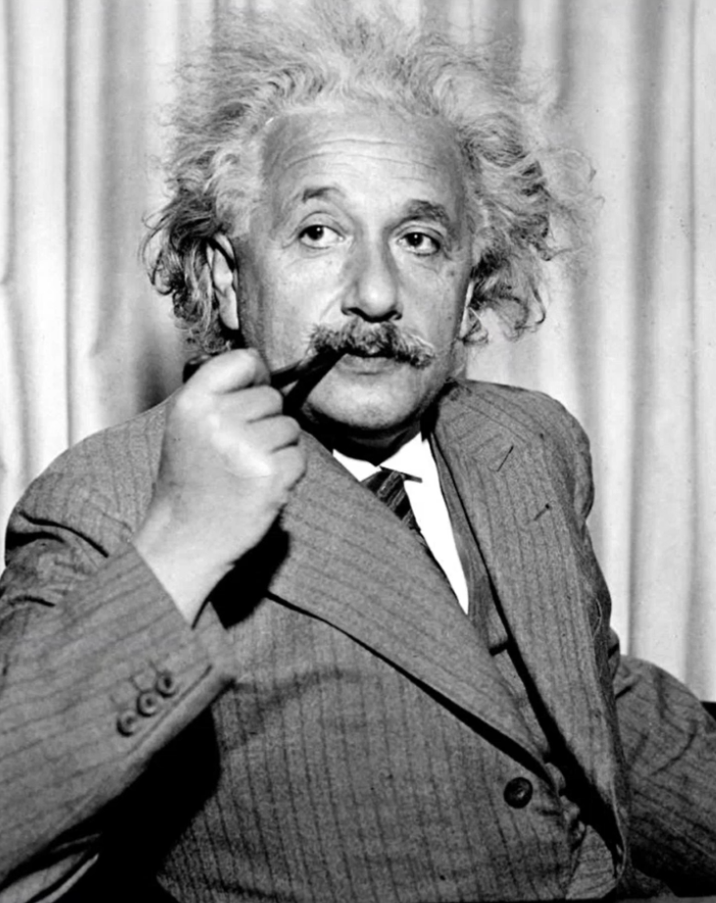
让你的文章读起来简单！
“The definition of genius is taking the complex and making it simple.”
- Albert Einstein

Slide 46
01
02
03
04
结构的逻辑性
语句的逻辑性
论证的逻辑性
写作规范
05
06
07
08
Abstract &
Keywords
Introduction
Main Results
Conclusion

Slide 47


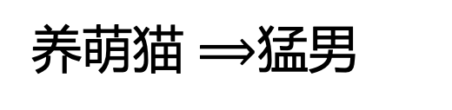
论证的逻辑性
论证的逻辑性是思维方式的问题
论证萌猫是“猛男必养”的宠物：
“数据表明，养萌猫的99.9%都是猛男”
这个论证对吗？
猛男 $⟹$养萌猫
养萌猫 $⟹$猛男

Slide 48
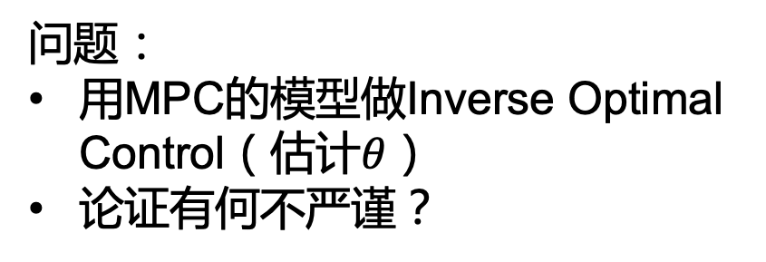
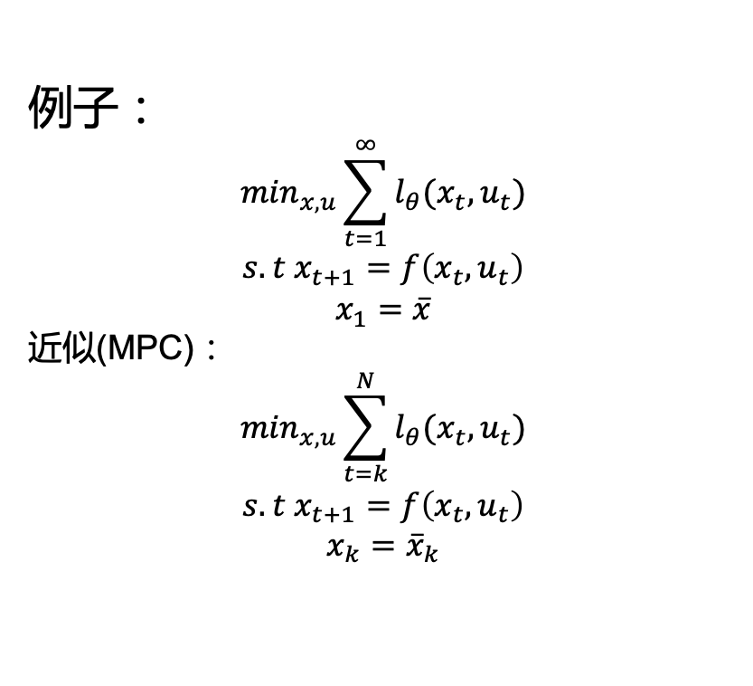
论证的逻辑性
论证的逻辑性是思维方式的问题
例子：
$$\min_{x,u}\sum_{t=1}^{∞}{l_{θ}(x_{t},u_{t})}$$
$$s.t x_{t+1}=f\left(x_{t},u_{t}\right)$$
$$x_{1}=\overline{x}$$
近似(MPC)：
$$\min_{x,u}\sum_{t=k}^{N}{l_{θ}(x_{t},u_{t})}$$
$$s.t x_{t+1}=f\left(x_{t},u_{t}\right)$$
$$x_{k}={\overline{x}}_{k}$$
问题：
用MPC的模型做Inverse Optimal Control（估计$θ$）
论证有何不严谨？
经过MPC近似的最优解和原来差多少？

Slide 49
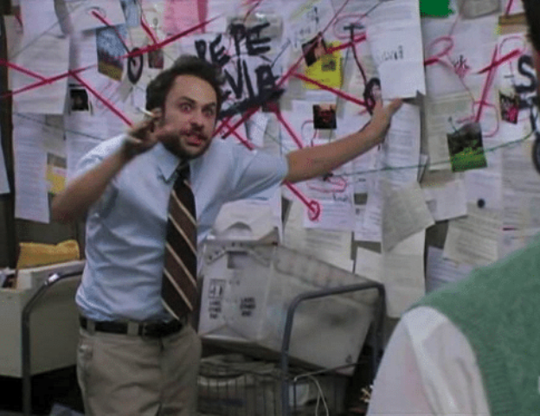
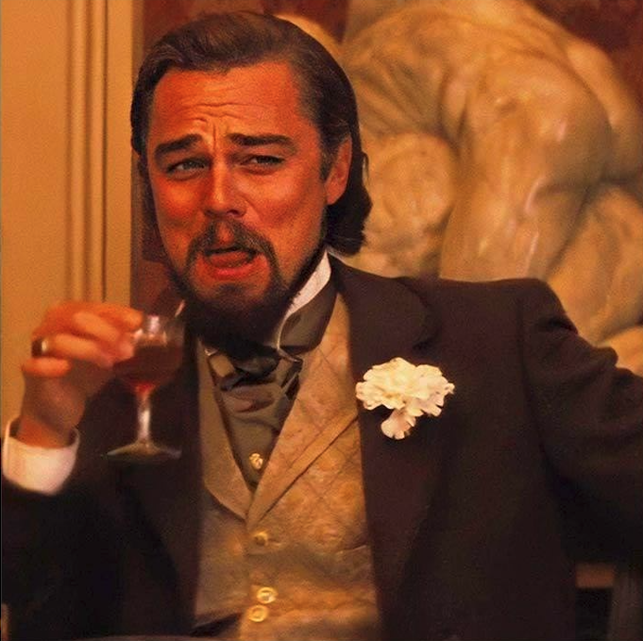
论证的逻辑性
张老师，我这周看了篇文献，他们没考虑xxx，我的创新是考虑了xxx，应该效果比他们的好
别人在文章里没写xxx，并不等于人家没考虑xxx因素
别人在文章里没写xxx，是不是人家试过xxx，觉得效果很差？
凭啥你考虑了xxx，你的效果就比别人的好？逻辑链条在哪里？

Slide 50
01
02
03
04
结构的逻辑性
语句的逻辑性
论证的逻辑性
写作规范
05
06
07
08
Abstract &
Keywords
Introduction
Main Results
Conclusion

Slide 51
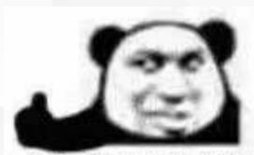
写作规范
文章行距
页眉页首间距
字体大小
引用格式
……
建议用Latex撰写论文
从杂志和期刊的出版商处下载Latex模版（包含cls、bibstyle文件）
每个杂志和会议有不同的要求！
Latex yyds！
建议使用 texlive + texmaker

Slide 52
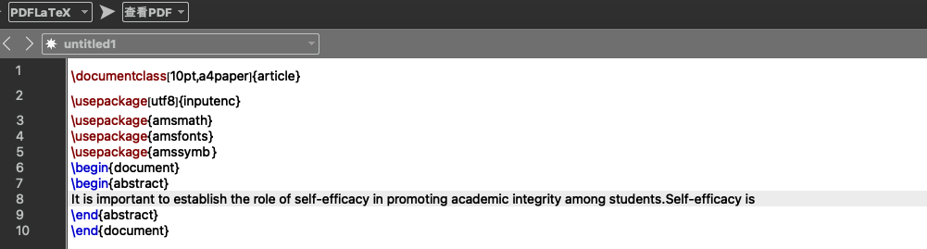
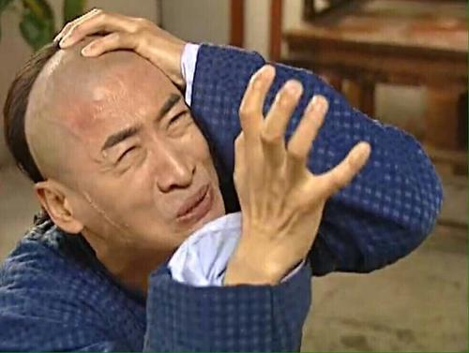
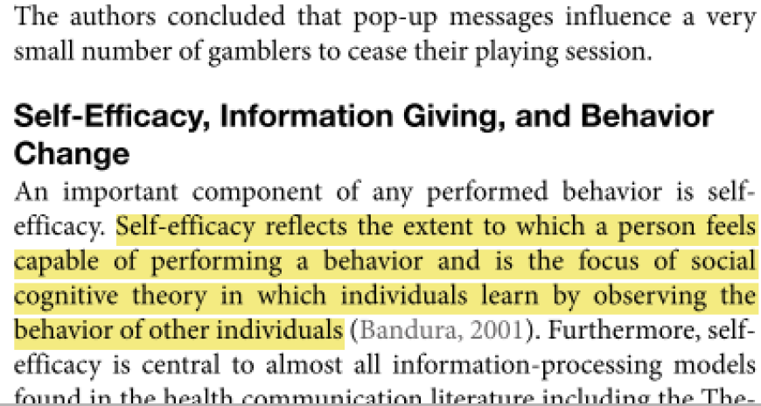
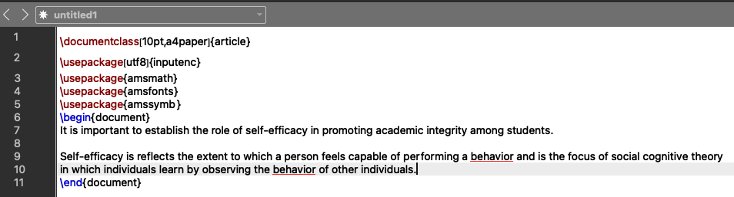
写作规范
怎么来描述“self-efficacy”?
剽窃!!!

Slide 53
写作规范
剽窃：
Idea、方法、证明等与原文高度雷同
直接抄袭原文中的语句但并未引用原文
避免“无意识的”剽窃（如介绍前人工作时）：
把原文的idea重新用自己的语言概括叙述
正确引用原文（不能“二手引用”，而需找到最初的原文！）
Self-efficacy is reflects the extent to which a person feels capable of performing a behavior and is the focus of social cognitive theory in which individuals learn by observing the behavior of other individuals.
还是剽窃!!!
Self-efficacy is reflects how much a person feels capable of doing a behavior. This is the focus of social cognitive theory whereby individuals learn by watching the behavior of other individuals.

Slide 54
写作规范
剽窃：
Idea、方法、证明等与原文高度雷同
直接抄袭原文中的语句但并未引用原文
避免“无意识的”剽窃（如介绍前人工作时）：
把原文的idea重新用自己的语言概括叙述
正确引用原文（不能二手引用，而需找到最初的原文！）
Self-efficacy is reflects the extent to which a person feels capable of performing a behavior and is the focus of social cognitive theory in which individuals learn by observing the behavior of other individuals.
OK！
Self-efficacy describes how capable a person feels to perform a behavior and is central to social cognitive theory.

Slide 55


写作规范
篡改数据：
让结果变得更“理想”
好的期刊和会议通常都要求公开源代码和数据集→确保实验结果的可复现性
是否应该报告不良结果？
是！
告诉同行别再踩你踩过的“坑”
只要不良结果没有影响你文章主要的贡献

Slide 56
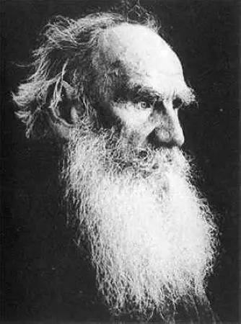
“ Anything's better than lying and deceit.”
Lev Tolstoy
Anna Karenina

